Slide 1
Lecture 3: Numerical Integrators, Symplecticity, Maps
J. Eldred
MATLAB/Python for Accelerators
February 7-18 2020

Slide 2
2
2
Numerical Integrators
2
Jeffrey Eldred | MATLAB/Python for Accelerators
Notes:
2
2
2
2
2
2

Slide 3
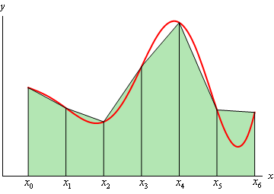
3
3
Numerical Integration
“Numerical integration” literately means a numerical approximation of the area under the curve. Like our familiar trapezoidal method.
You can use np.trapz(x,y)
But “numerical integration” is also a term that refers to methods which solve ordinary differential equations with a succession of small timesteps.
3
Jeffrey Eldred | MATLAB/Python for Accelerators
Notes:
3
3
3
3
3
3

Slide 4
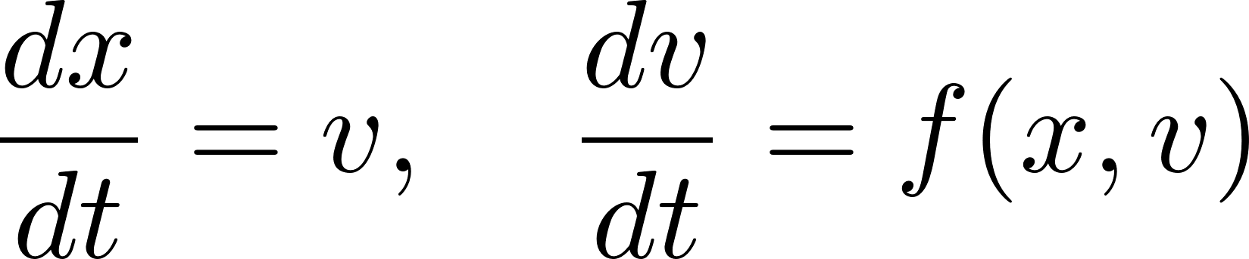
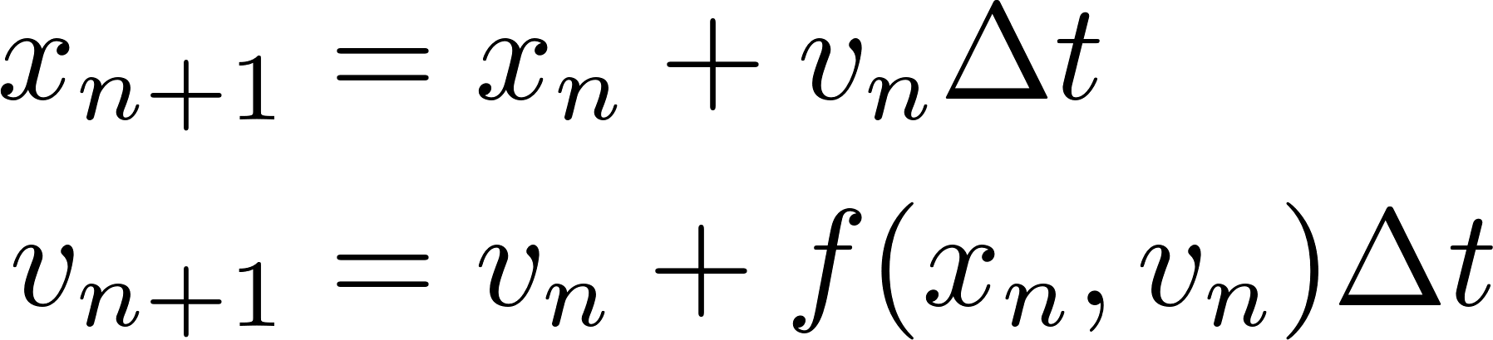
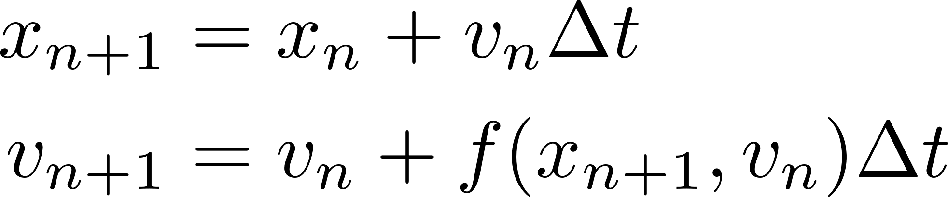
4
4
Euler-Cromer Method
Consider the differential equations:
Euler Method:
Euler-Cromer Method:
These two methods look pretty similar, what is the difference?
Euler-Cromer is symplectic, whereas Euler is not.
Non-symplectic methods may appear fine in the short term, but have errors in phase-space conservation that accumulate over the long term.
See script lec3_euler.py
4
Jeffrey Eldred | MATLAB/Python for Accelerators
Notes:
4
4
4
4
4
4

Slide 5
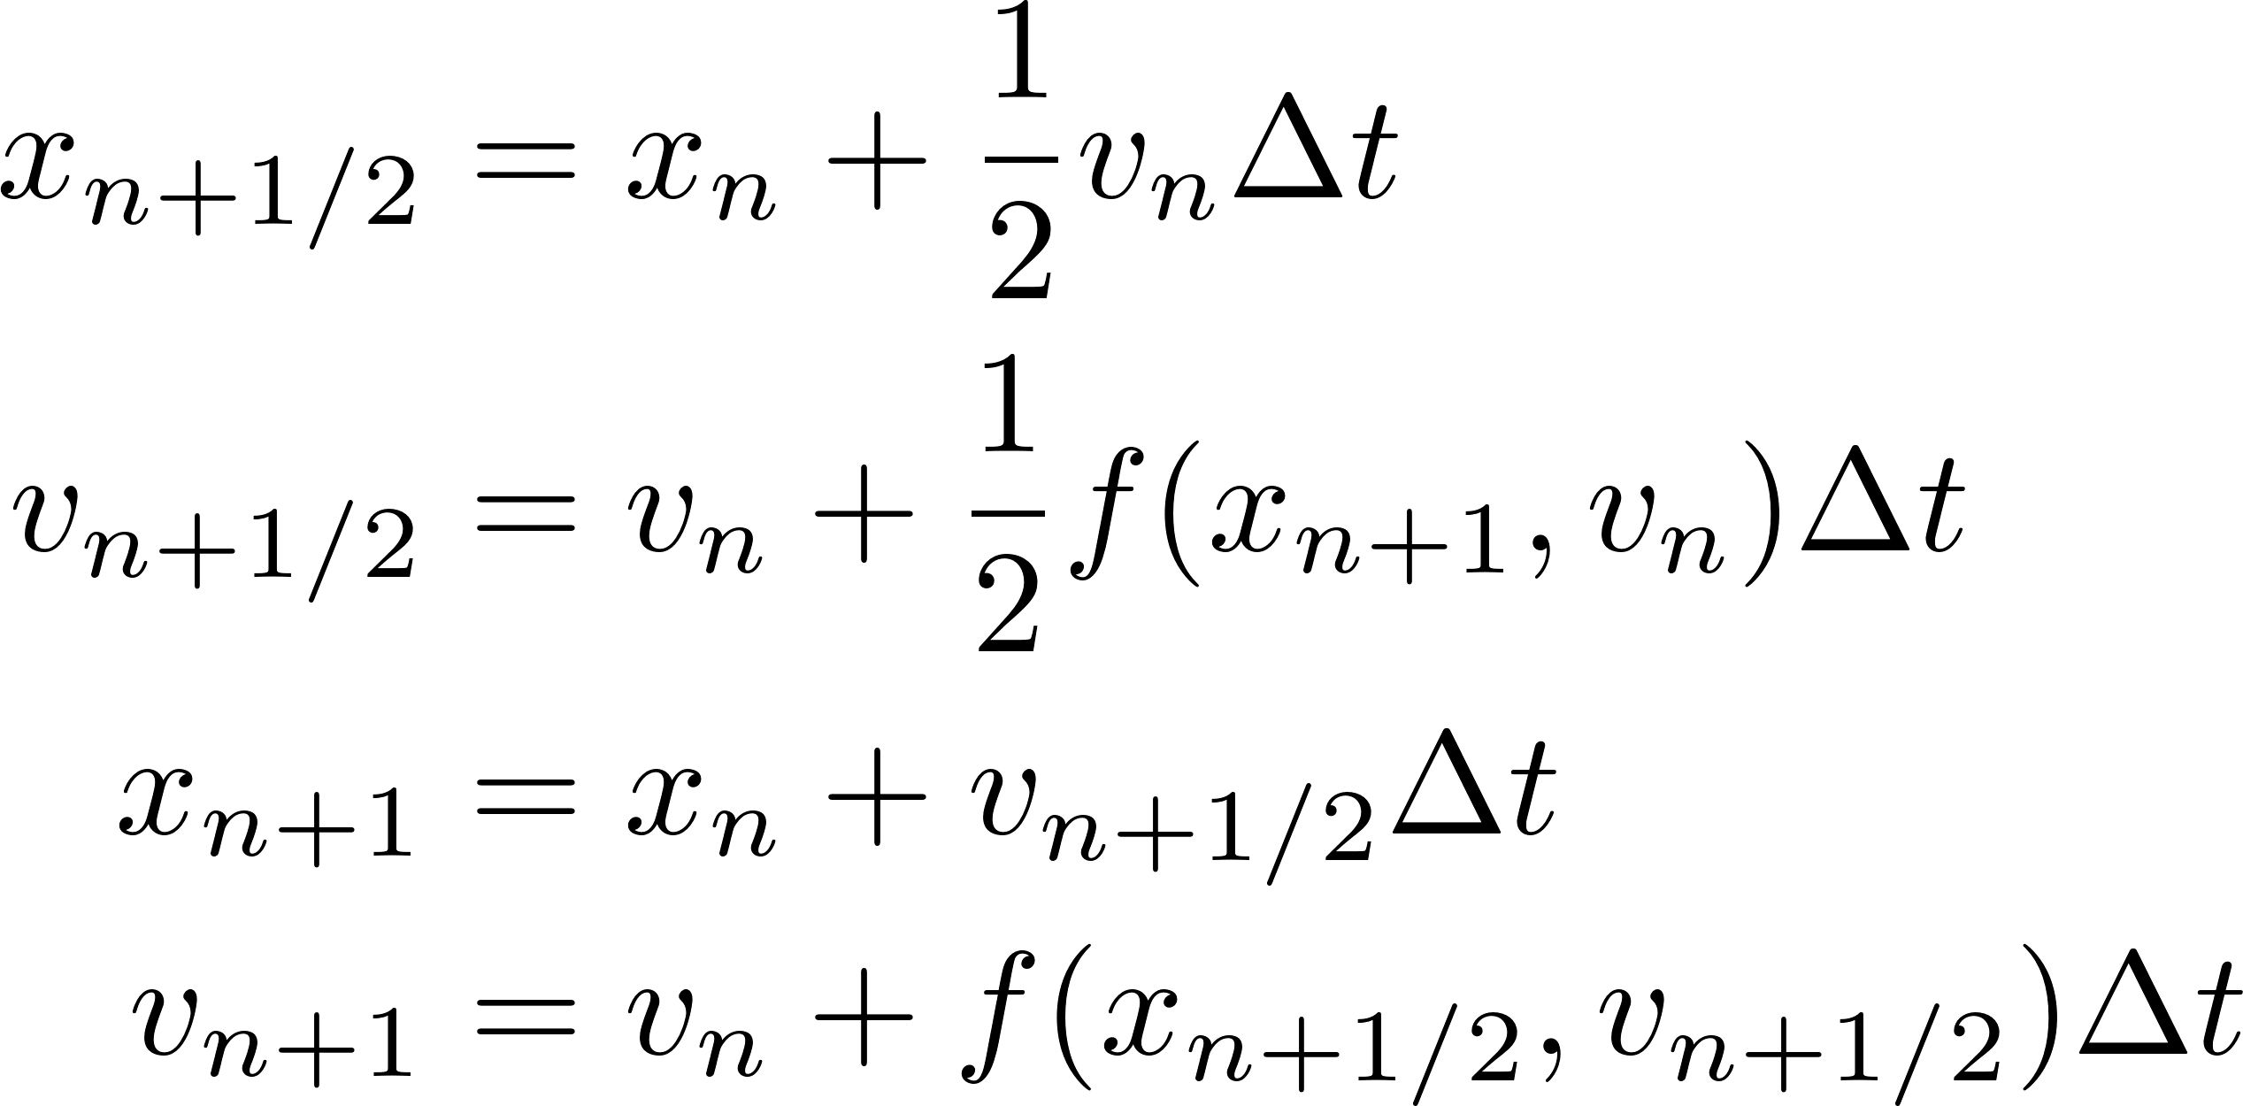
5
5
Euler-Richardson Method
Consider the differential equations:
Euler-Cromer Method:
1st order
symplectic
2nd order
non-symplectic
Euler-Richardson Method
or 2nd-order Runge-Kutta:
Euler-Richardson is “non-symplectic”, but it is a second-order method which means errors scale with Δt² instead of Δt.
See script lec3_fall.py
5
Jeffrey Eldred | MATLAB/Python for Accelerators
Notes:
5
5
5
5
5
5

Slide 6
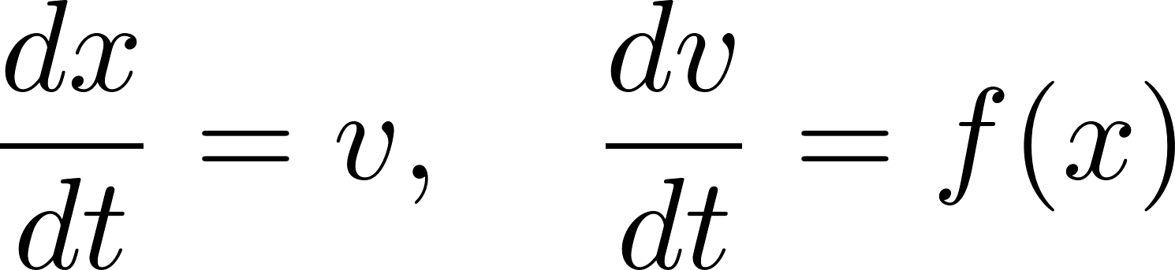
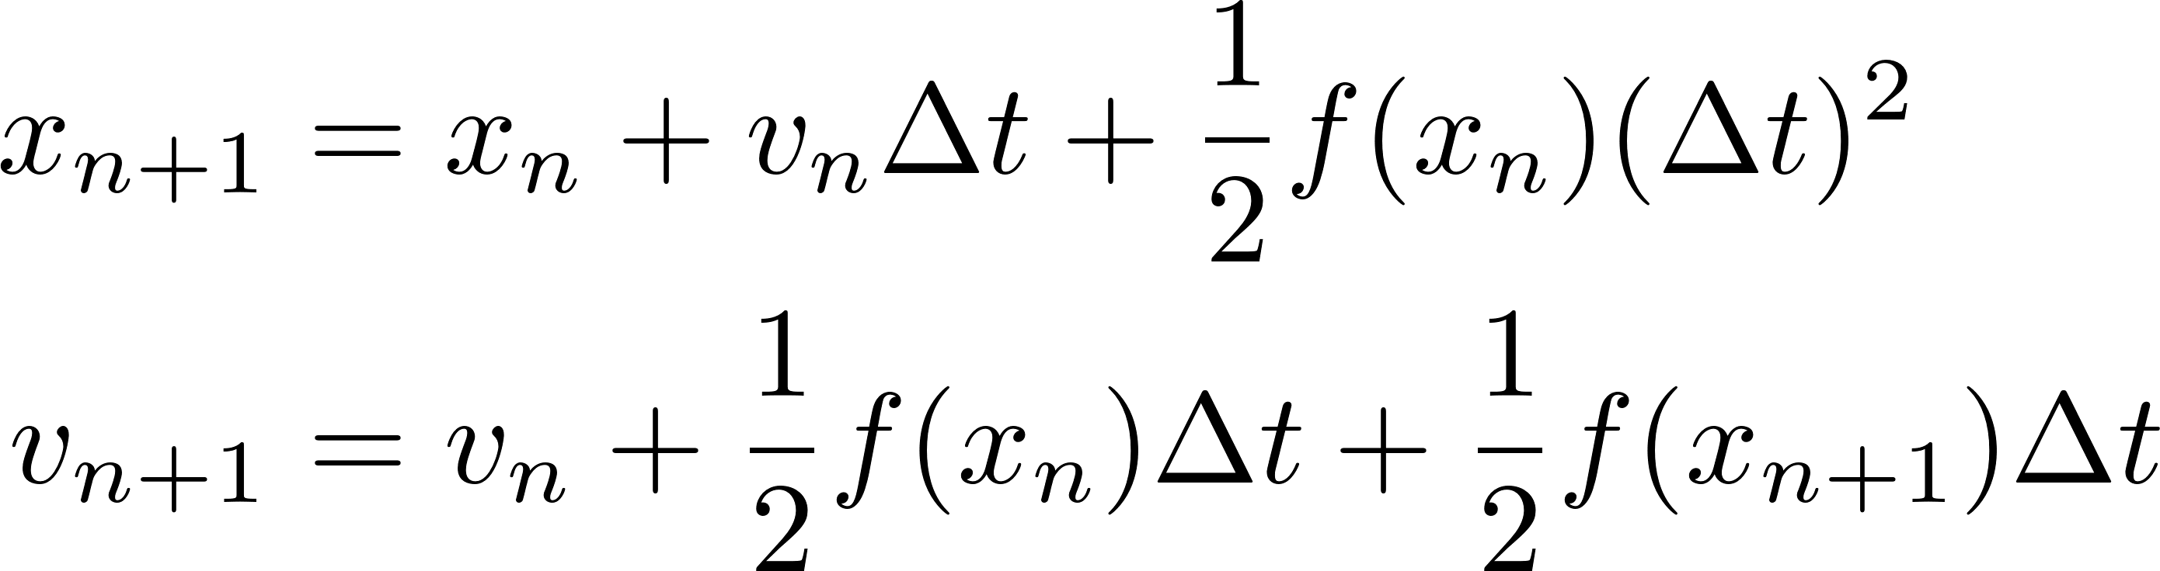
6
6
Stormer-Verlet Method (2nd-order, symplectic)
If the force doesn’t depend on v:
2nd order
symplectic
Velocity Verlet:
6
Jeffrey Eldred | MATLAB/Python for Accelerators
Notes:
6
6
6
6
6
6

Slide 7
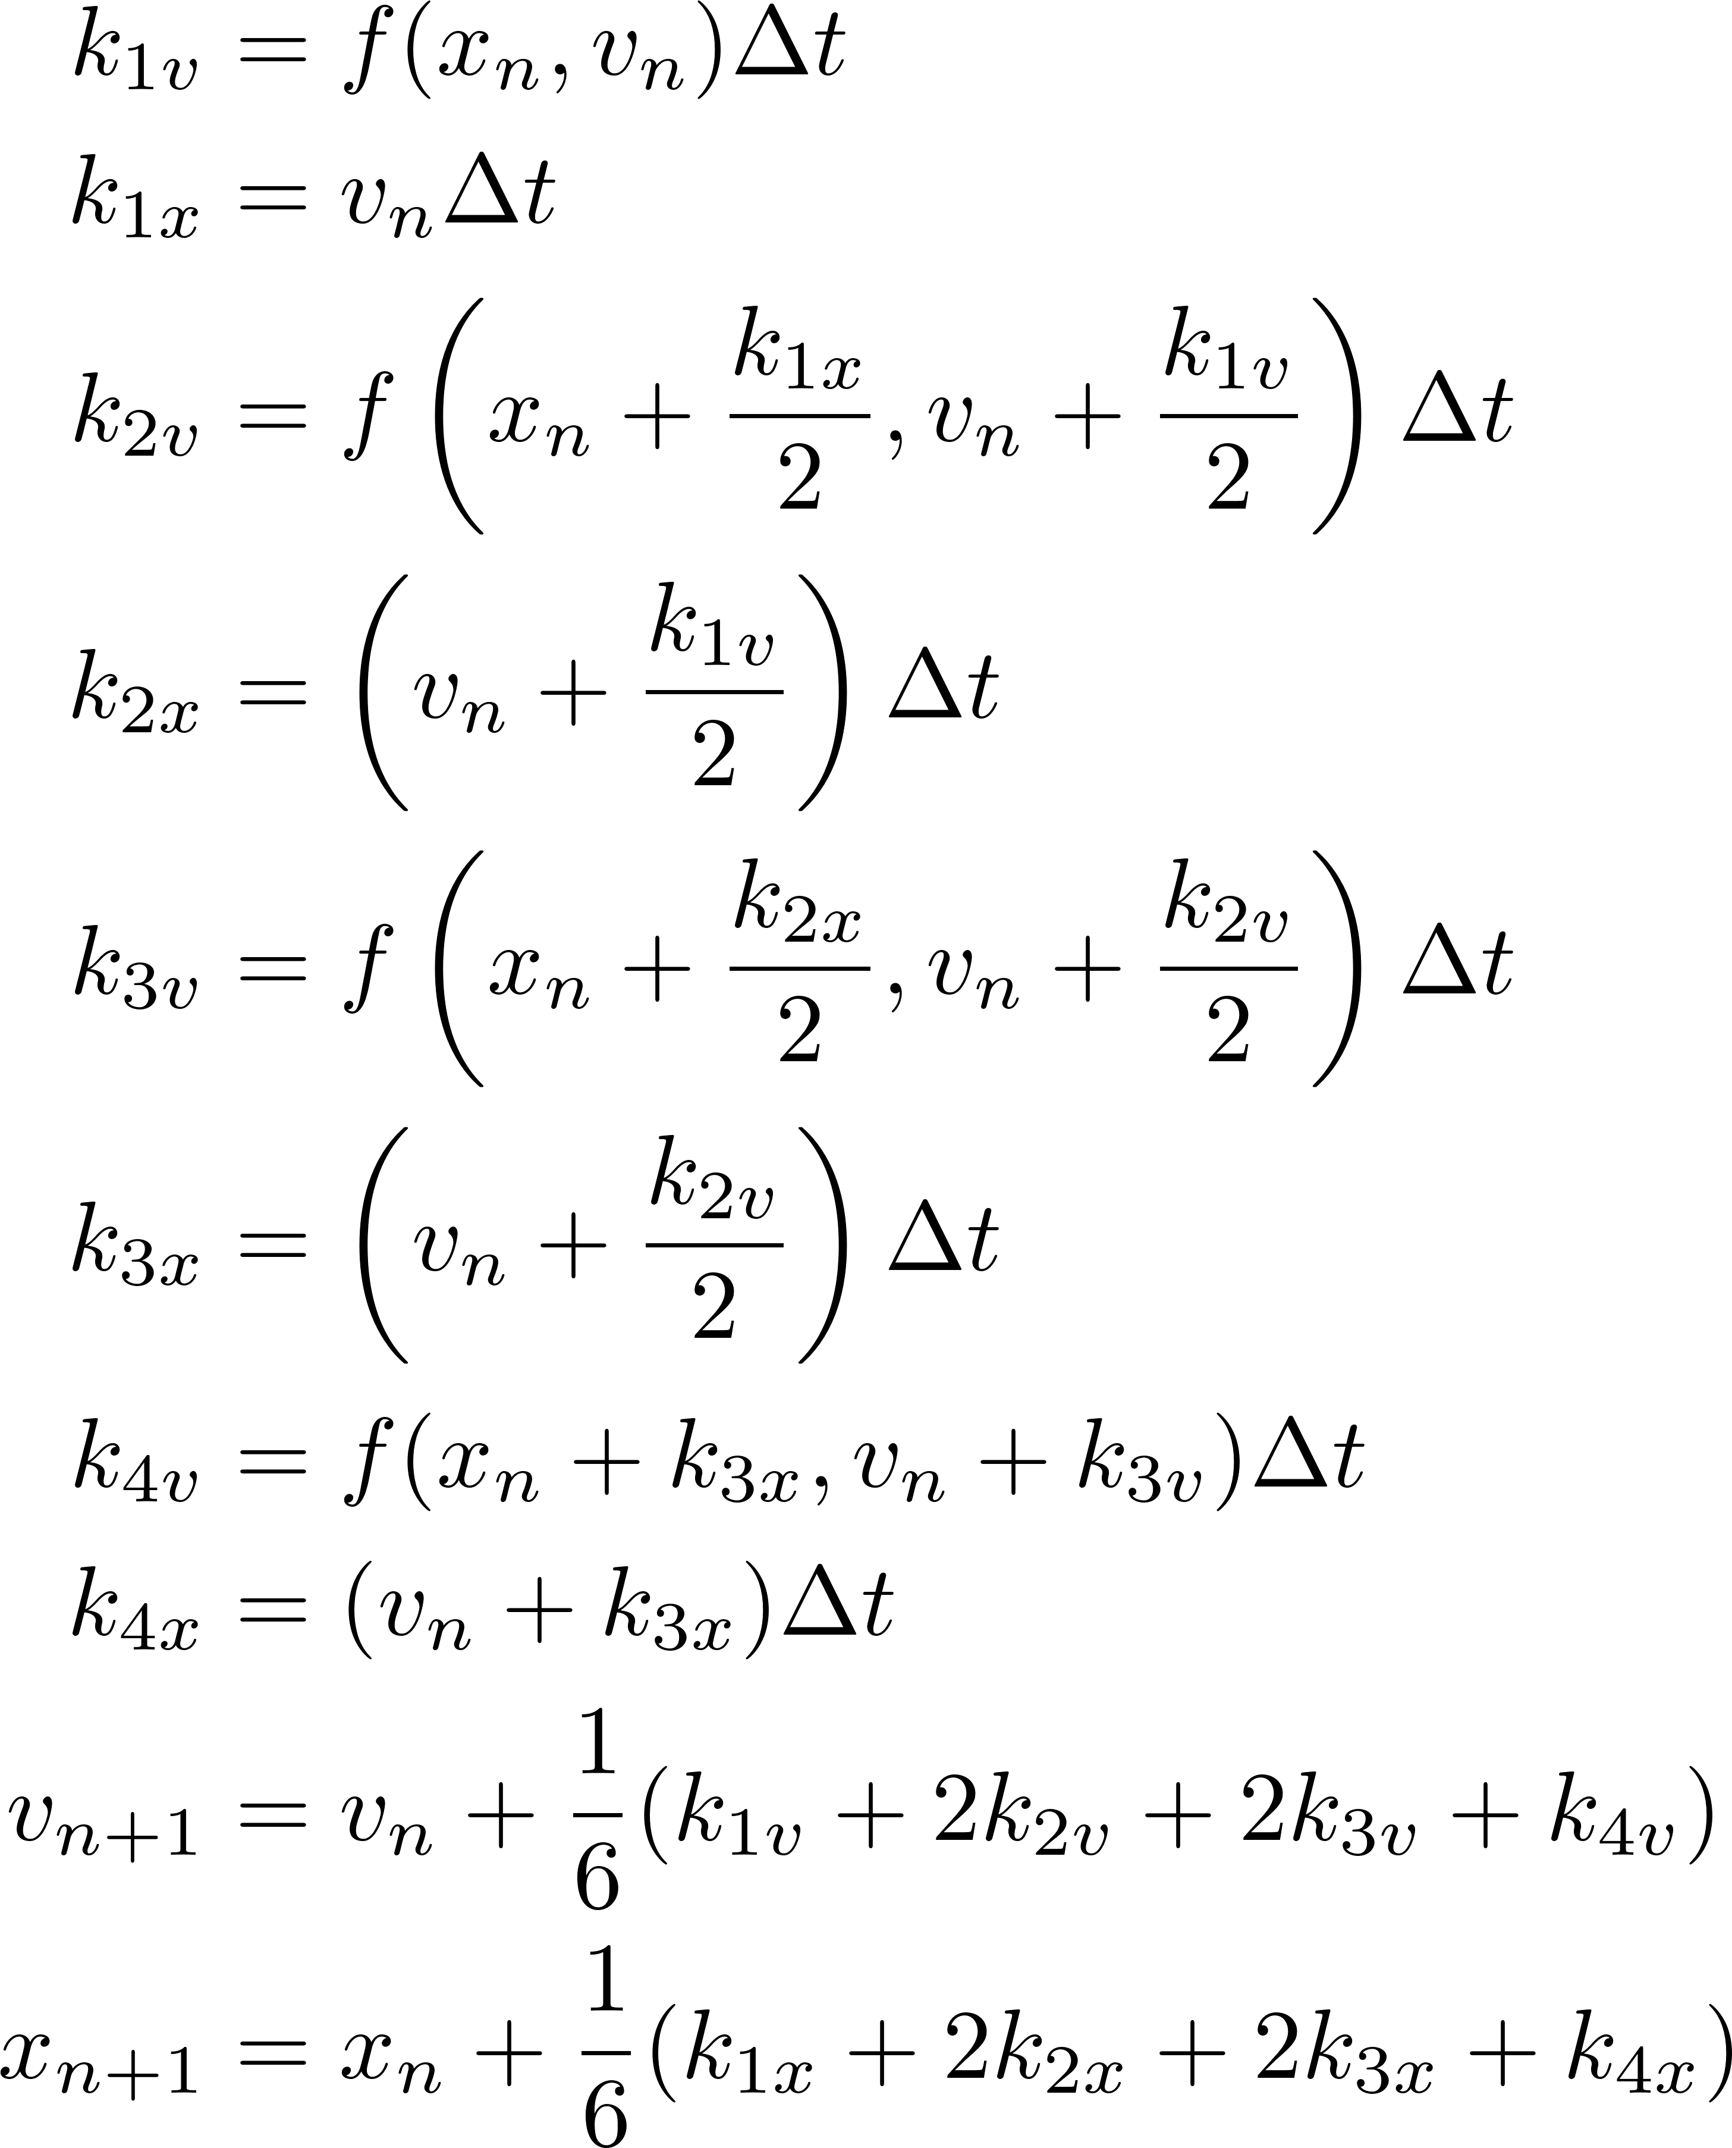
7
7
4th-order Runge-Kutta (non-symplectic)
4th-Order
Runge-Kutta:
7
Jeffrey Eldred | MATLAB/Python for Accelerators
Notes:
7
7
7
7
7
7

Slide 8
8
8
Symplecticity
8
Jeffrey Eldred | MATLAB/Python for Accelerators
Notes:
8
8
8
8
8
8

Slide 9
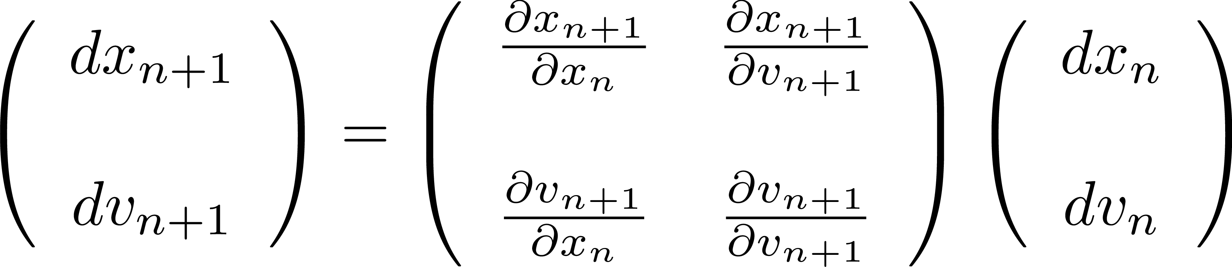
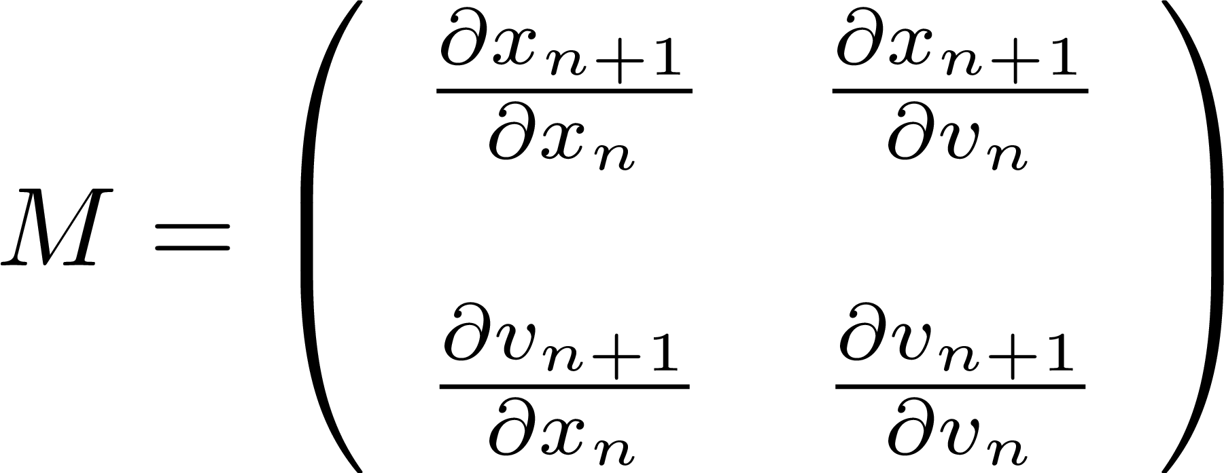
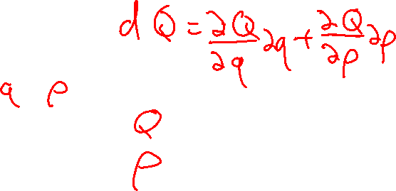
9
Jacobian – 2x2 matrix
(Sometimes this is called J for Jacobian, but I’ll leave it as M.)
9
Jeffrey Eldred | MATLAB/Python for Accelerators
Notes:
9
9
9

Slide 10
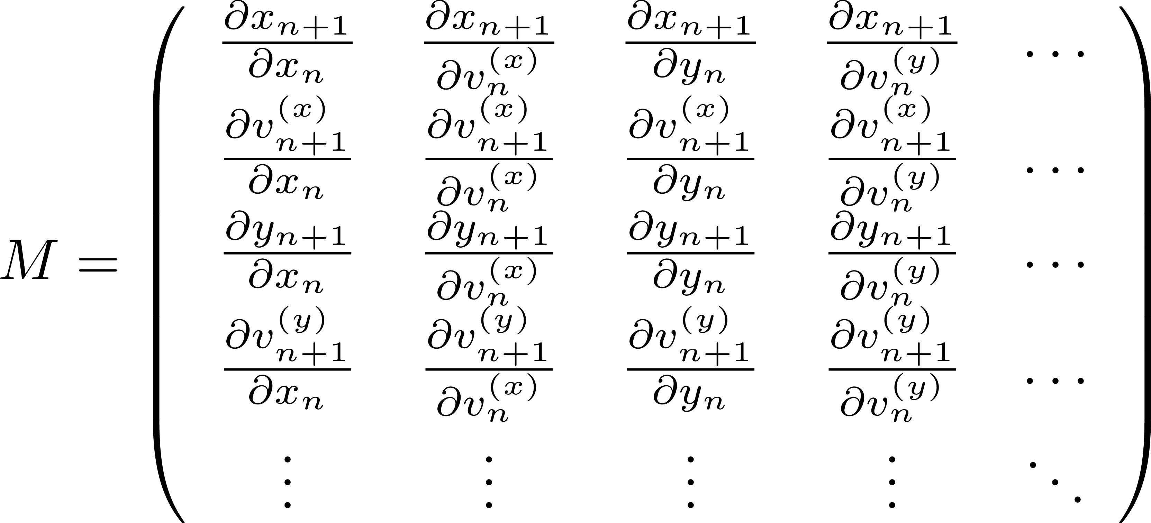
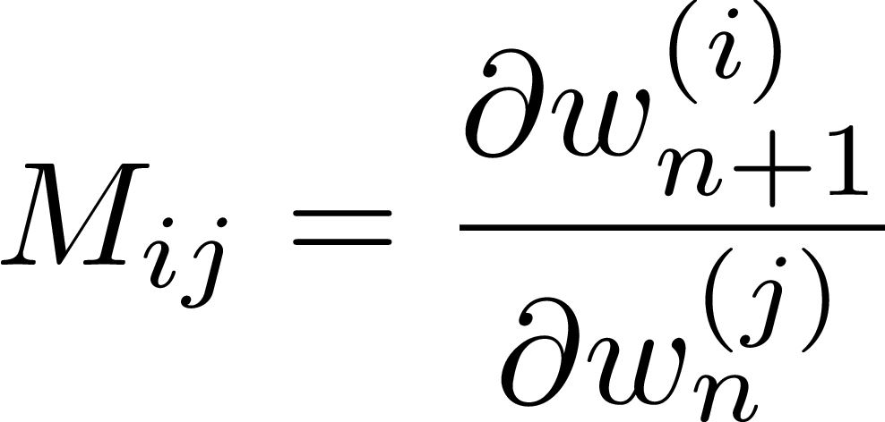
10
Jacobian – 2nx2n matrix
The physics convention is generally x_{n}, v^{(x)}_{n}, y_{n}, v^{(y)}_{n}….
Occasional you will see it writtem x_{n},y_{n},…v^{(x)}_{n},v^{(y)}_{n}…
10
Jeffrey Eldred | MATLAB/Python for Accelerators
Notes:
10
10
10

Slide 11

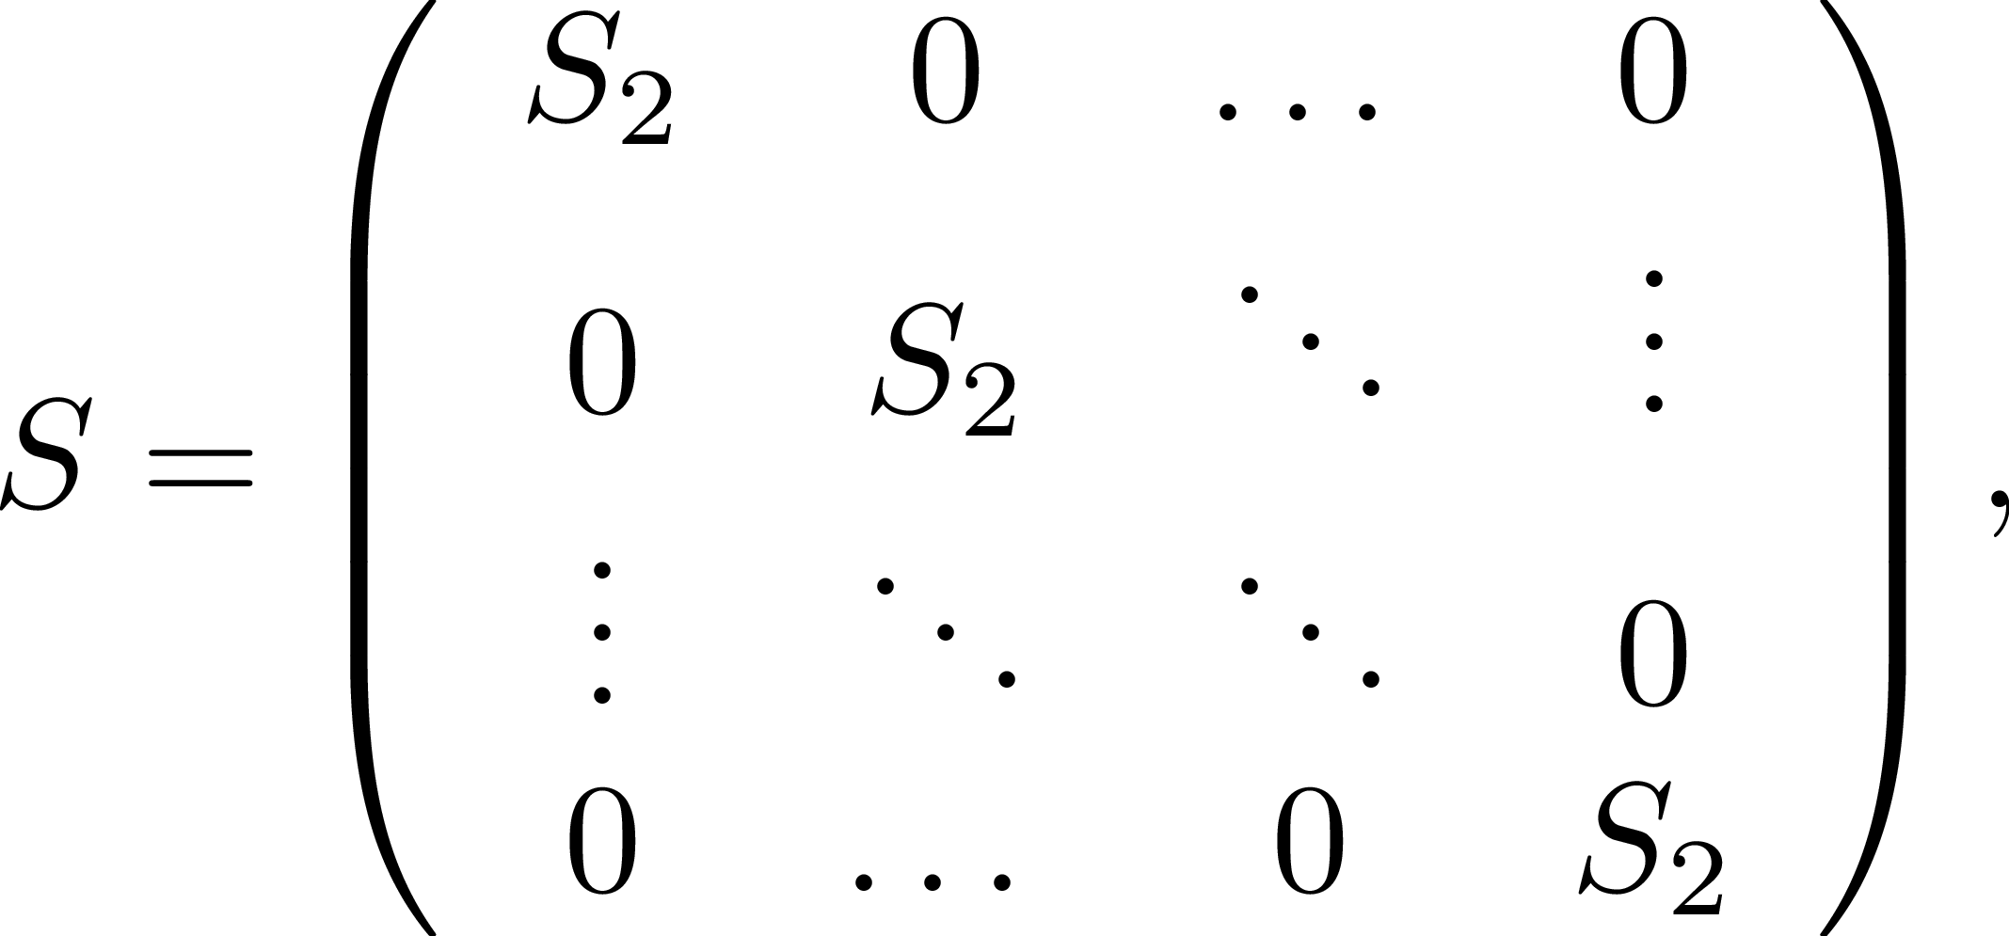
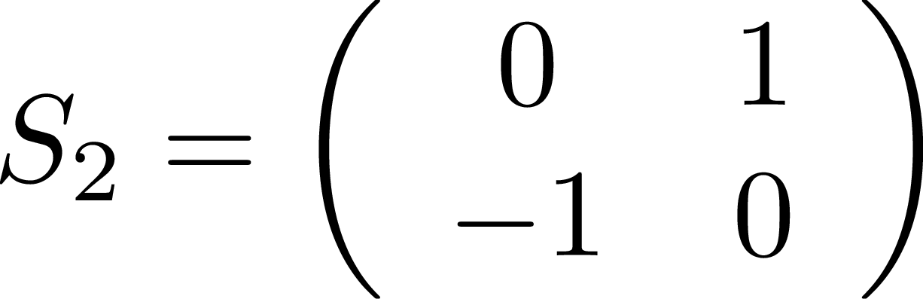

11
Symplecticity – 2nx2n matrix
For a 2x2 matrix, the map is symplectic if det M = 1 .
For a 2Nx2N system, to be symplectic it must also be true that:
Jacobian matrix M:
where
where
11
Jeffrey Eldred | MATLAB/Python for Accelerators
Notes:
11
11
11

Slide 12
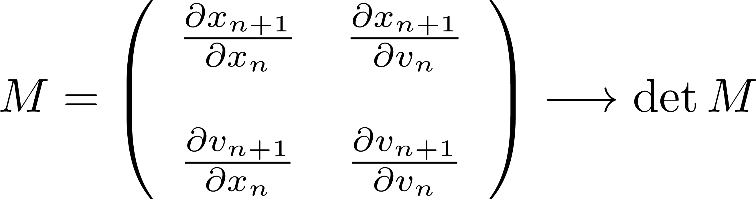
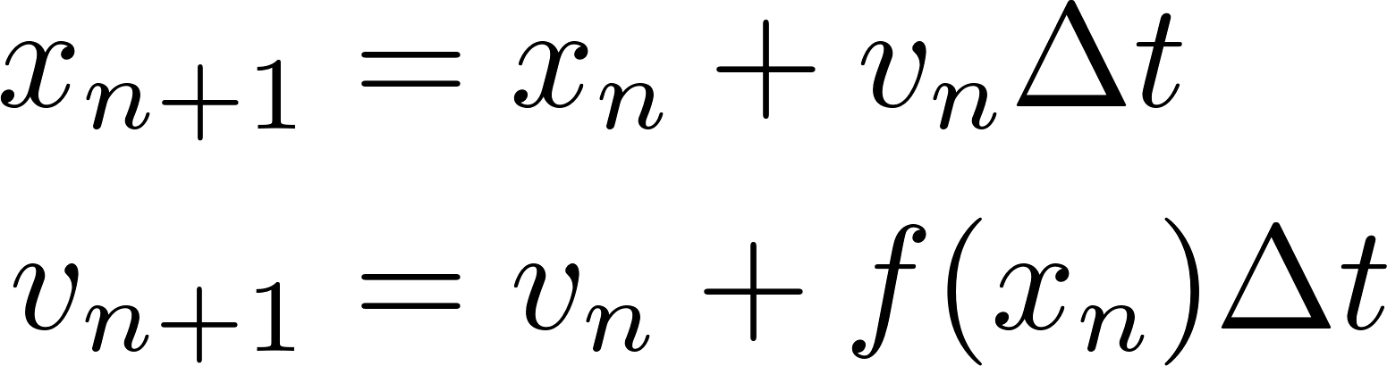
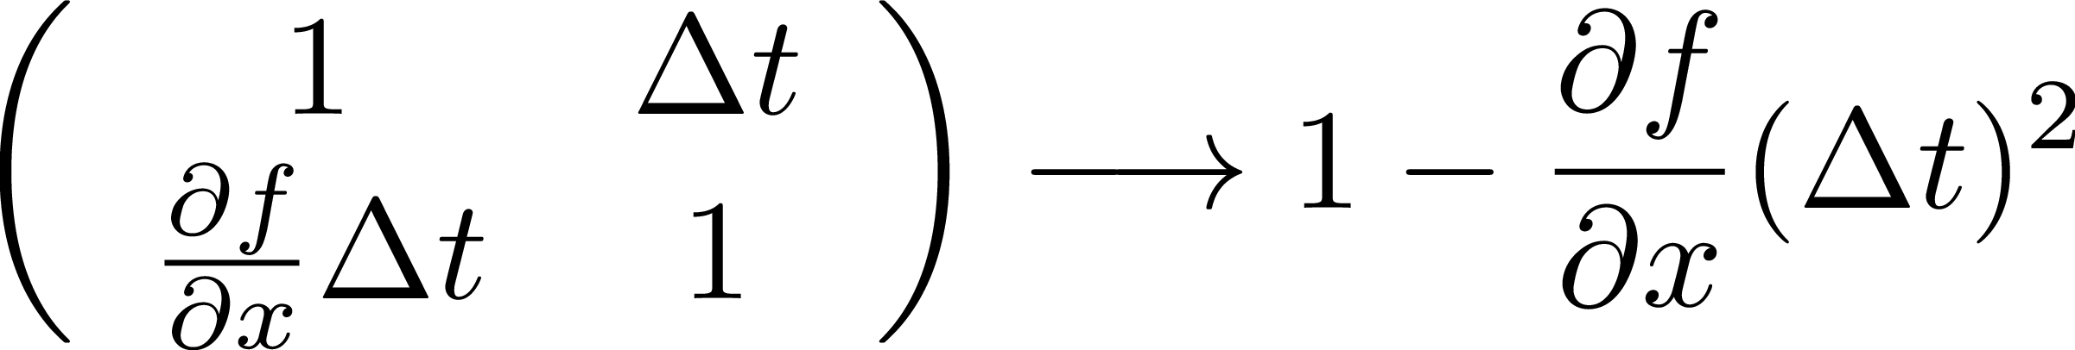
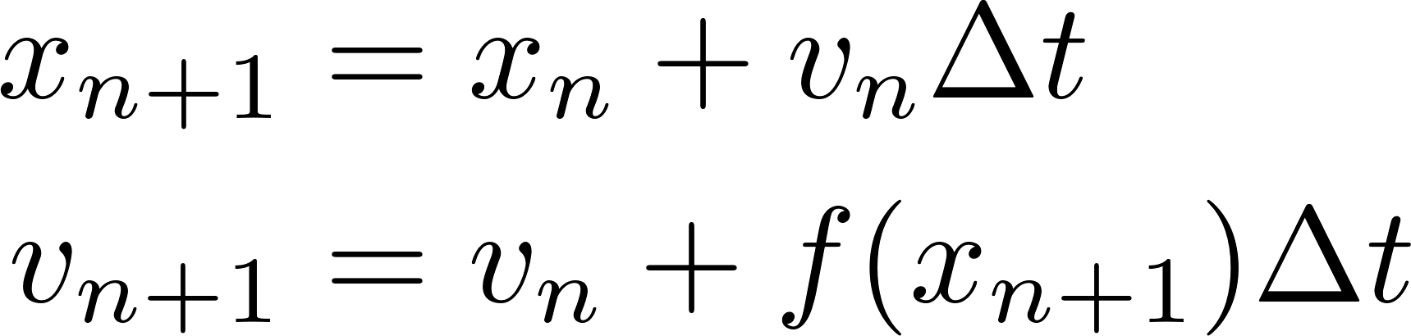
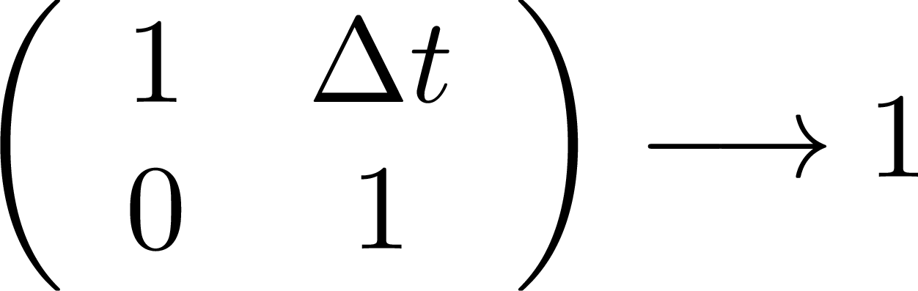
12
Euler vs Euler-Cromer
Jacobian matrix
E:
EC:
Euler-Cromer is symplectic, while Euler is not.
12
Jeffrey Eldred | MATLAB/Python for Accelerators
Notes:
12
12
12

Slide 13
13
13
Analyzing Trajectories
13
Jeffrey Eldred | MATLAB/Python for Accelerators
Notes:
13
13
13
13
13
13

Slide 14
14
14
Particle and Stability
How can you tell if a particle trajectory is stable?
- stable motion is bounded, which mean you can identify a line on either side that the particle will never cross.
Particle motion is usually restricted by physical boundaries anyway.
- a particle can be “lost” because it crosses a physical boundary even if it is “stable” in the sense of not having a trajectory towards infinity.
It is technically possible for particle motion to unstable in some phase-space coordinates while stable in the others.
If you are tracking an ensemble property such as emittance, it is best to exclude unstable or lost particles from the calculation.
- if you are tracking ensemble behavior over time, you may want to also retro-actively exclude particles if they are ultimately going to be lost.
14
Jeffrey Eldred | MATLAB/Python for Accelerators
Notes:
14
14
14
14
14
14

Slide 15
15
15
Particles and Chaos
When do a particle have a chaotic trajectory?
1. highly aperiodic motion i.e. not guaranteed to return to itself.
2. nearby trajectories are highly divergent and unpredictably distinct.
Chaos does not necessarily mean a trajectory is unstable, chaotic motion can exist within a bounded region.
- That means there is some stable periodic motion outside this region.
Frequency Map Analysis plots make use of an indicator called “diffusion”:
- Take an FFT of the first half and second half, how much has the peak tune-changed? A discrepancy indicates chaos, from a resonance.
SALI/GALI method track chaos by looking at whether N nearby points retain their orientation with respect to each other.
15
Jeffrey Eldred | MATLAB/Python for Accelerators
Notes:
15
15
15
15
15
15

Slide 16
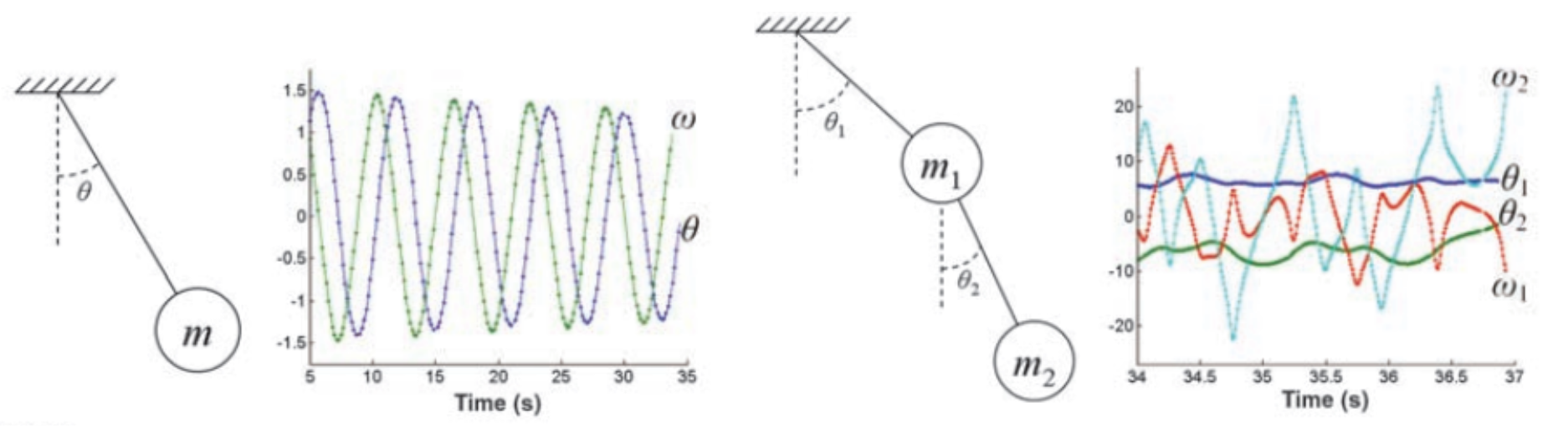
Frequency Map Analysis (FMA)
A particle trajectory looks bounded and stable, in the short term, but is there a way to know if remain stable?
A particle with a stable frequency of oscillation is likely to remain stable, a particle with changing frequency - called diffusion – is a sign of particle resonances and instability.
Originally from Astronomy - imagine a planet wobbling out of orbit.
16
Jeffrey Eldred | MATLAB/Python for Accelerators
Notes:
16
16
16
16

Slide 17
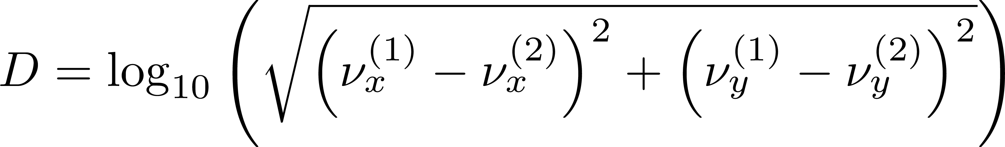
17
FMA Algorithm
Divide the space into a grid of initial phase-space coordinates x, y, x’, y’, s, δ. Typically, a 2D grid varying x and y, but leaving the initial x’=0, y’=0, s=0, δ=0 fixed.
For each initial point, calculate the peak horizontal and vertical oscillation frequencies for the first N turns (typically 1000 turns) and then calculate the frequencies again for the next N turns.
Calculate the diffusion coefficient, the log frequency difference:
Color a map of initial x, y coordinates and averaged ν_{x}, ν_{y} .
17
Jeffrey Eldred | MATLAB/Python for Accelerators
Notes:
17
17
17

Slide 18
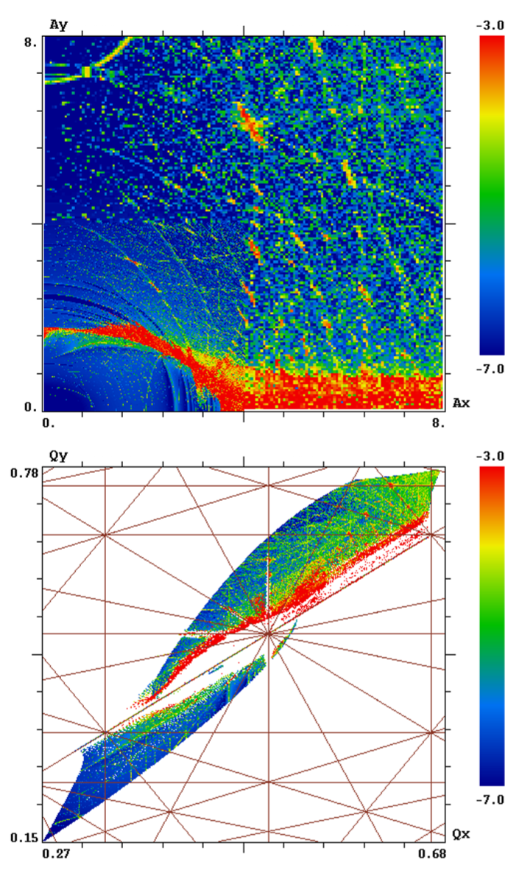
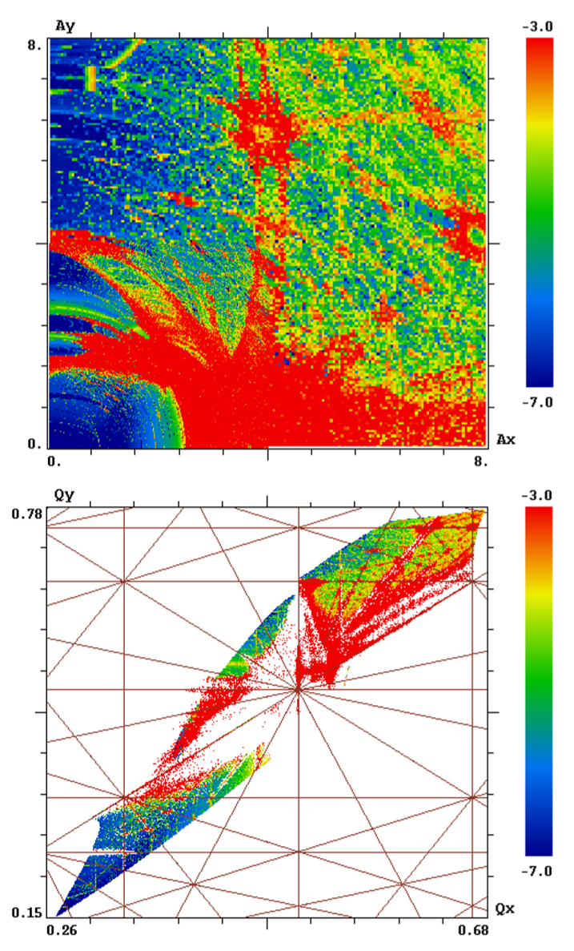
18
FMA Example
Ideal Booster Lattice
Lattice with 20% Error
Valishev,
V. Lebedev,
HB2016
18
Jeffrey Eldred | MATLAB/Python for Accelerators
Notes:
18
18
18

Slide 19
19
19
Maps
19
Jeffrey Eldred | MATLAB/Python for Accelerators
Notes:
19
19
19
19
19
19

Slide 20
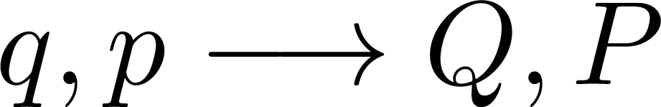
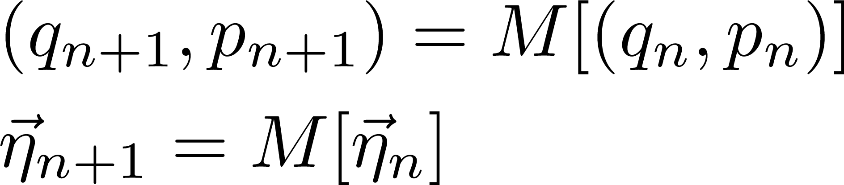
Maps
Maps can be presented as new coordinates Q(q,p), P(q,p) from old coordinates q,p:
Or a map named M, which can be applied to iterate q_{n+1}, p_{n+1} from original coordinates q_{n},p_{n}:
If a map applied to a point is that same point, its called fixed point.
If N iterations of a map returns to the same point, it’s a n-cycle.
A map applied to a line falls on the same line, invariant curve
An invariant exists, it maps onto itself.
20
Jeffrey Eldred | MATLAB/Python for Accelerators
Notes:
20
20
20
20

Slide 21
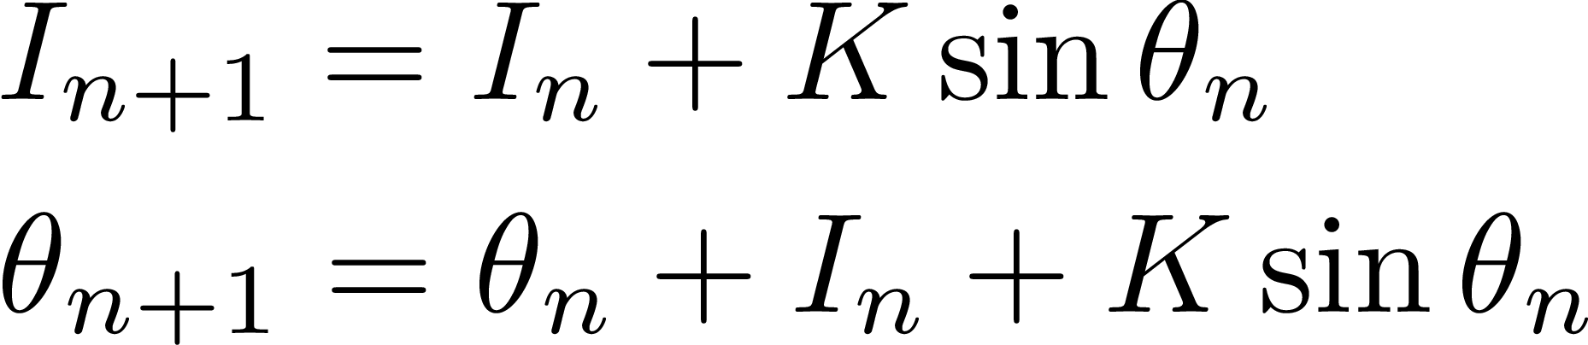
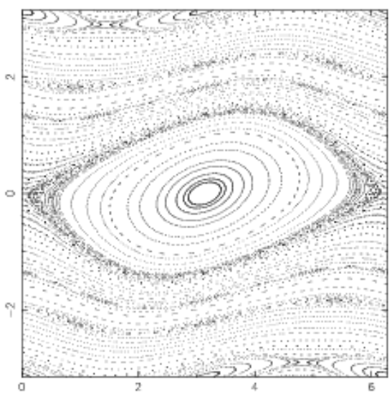
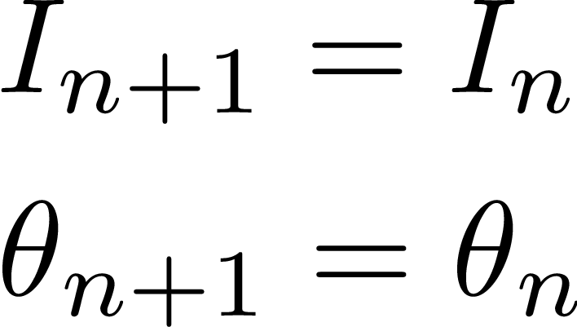
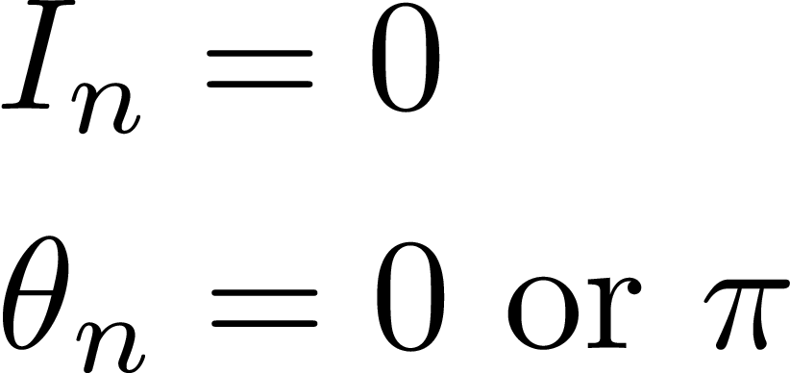

Example: Taylor-Greene-Chirikov Map / Standard Map
Fixed points:
If K is small enough, this map converges to the Hamiltonian pendulum system we have used to represent RF systems
21
Jeffrey Eldred | MATLAB/Python for Accelerators
Notes:
21
21
21
21

Slide 22
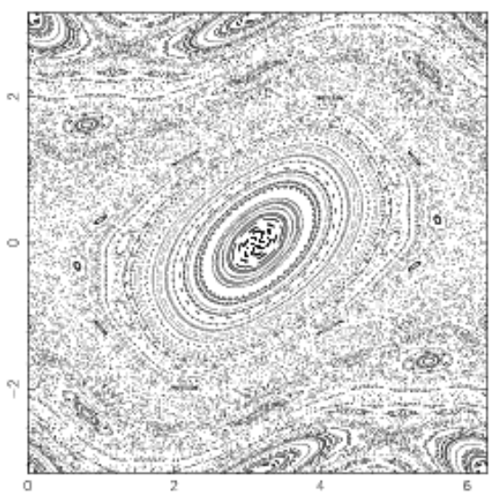

Example: Taylor-Greene-Chirikov Map / Standard Map
As K increases,
- resonance islands form.
- there are chaotic regions.
- invariant curves still exist, even around islands or interleaved with chaos.
22
Jeffrey Eldred | MATLAB/Python for Accelerators
Notes:
22
22
22
22

Slide 23
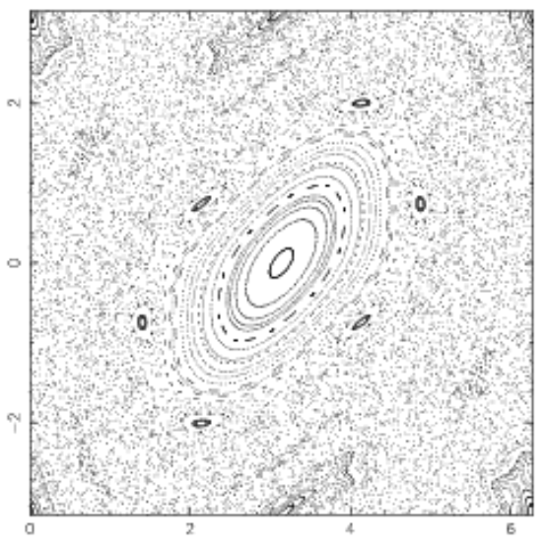
Example: Taylor-Greene-Chirikov Map / Standard Map
As K increases further,
- stable area shrinks.
- few resonant islands.
- chaotic regions expand.
23
Jeffrey Eldred | MATLAB/Python for Accelerators
Notes:
23
23
23
23

Slide 24
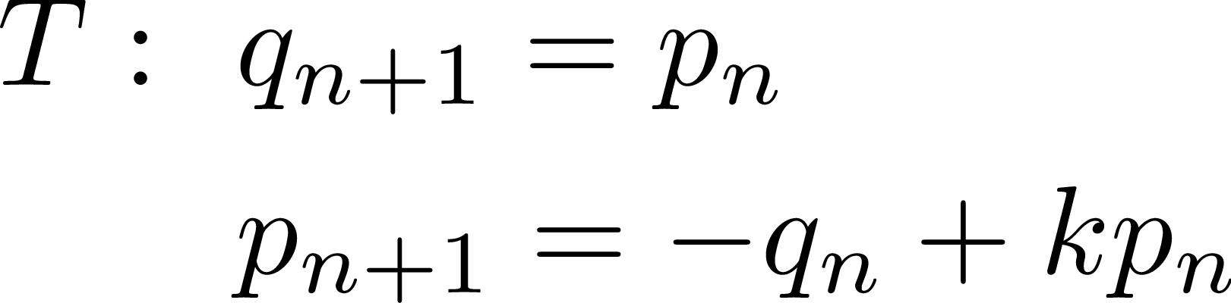

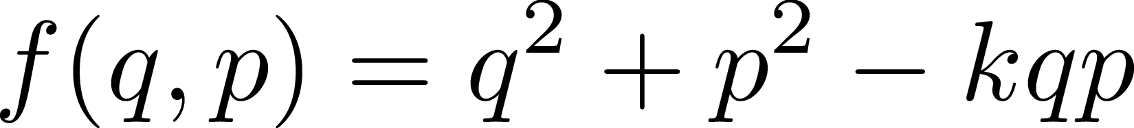
Example: A Linear Map
One example of a linear map:
There will be an invariant curve of the form:
We can find, A, B, C by solving the equation
24
Jeffrey Eldred | MATLAB/Python for Accelerators
Notes:
24
24
24
24

Slide 25
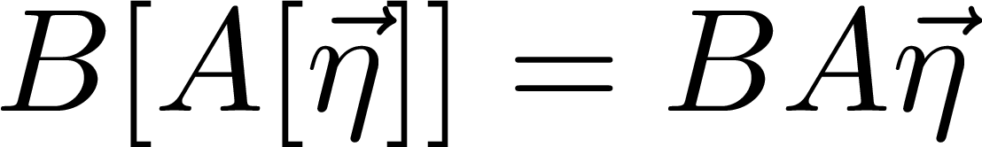

Linear Maps
The properties of a linear map is what you’d expect:
Linear maps can always be written as matrices.
Compositions of maps, is just the multiplication of matrices.
N iterations of a map, is just that matrix to the Nth power, which can be calculated very simply by eigendecomposing it:
For a map to be stable (bounded indefinitely), the eigenvalues should be e^{iQ},e^{-iQ}, i.e progression in a Courant-Snyder ellipse.
25
Jeffrey Eldred | MATLAB/Python for Accelerators
Notes:
25
25
25
25

Slide 26
26
26
Poincare Sections
26
Jeffrey Eldred | MATLAB/Python for Accelerators
Notes:
26
26
26
26
26
26

Slide 27
27
Accelerators & Maps
Application 1: Hamiltonian Motion
- Average out the impact of individual accelerator impacts over many revolutions to treat the system as a continuous Hamiltonian system.
- Approximate that continuous Hamilitonian with many small steps.
Application 2: Tracking Code
- The accelerator is a sequence of many different individual maps.
- For continuous nonlinear-elements, such as thick sextupole or space-charge force, approximate each of those as series of thin maps.
- Track the aggregate effect of all those maps around ring and over time.
Application 3: Poincare Section
- The accelerator is a complex system which can be observed empirically, or tracked by one of the above two methods.
- Analyze the behavior of the system as a map on a Poincare surface.
27
Jeffrey Eldred | MATLAB/Python for Accelerators
Notes:
27
27
27

Slide 28
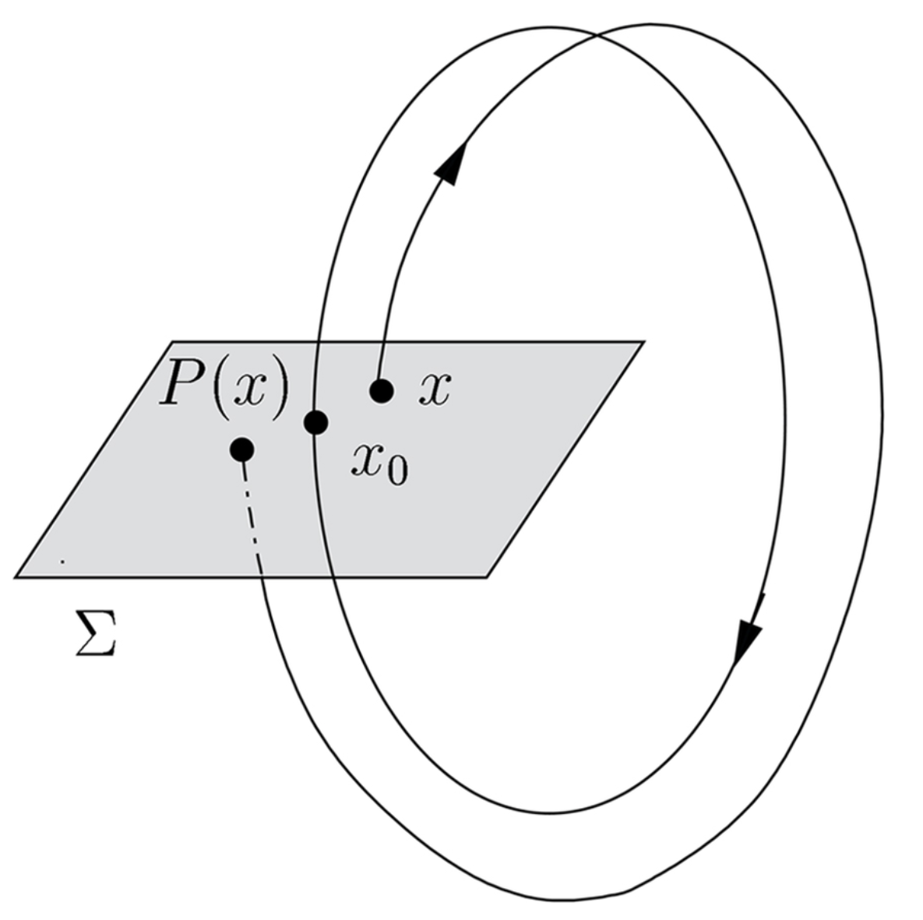
28
Poincare Section
Another way to visualize a Hamiltonian system with more than 2 dimensions.
Track where the particle passes through a surface where all other coordinates are held fixed.
Each pass, the 2D coordinates of the surface will be mapped to new values, the same mapping each pass.
The Poincare section may have fixed points or invariant features even when the trajectory generally does not.
28
Jeffrey Eldred | MATLAB/Python for Accelerators
Notes:
28
28
28

Slide 29
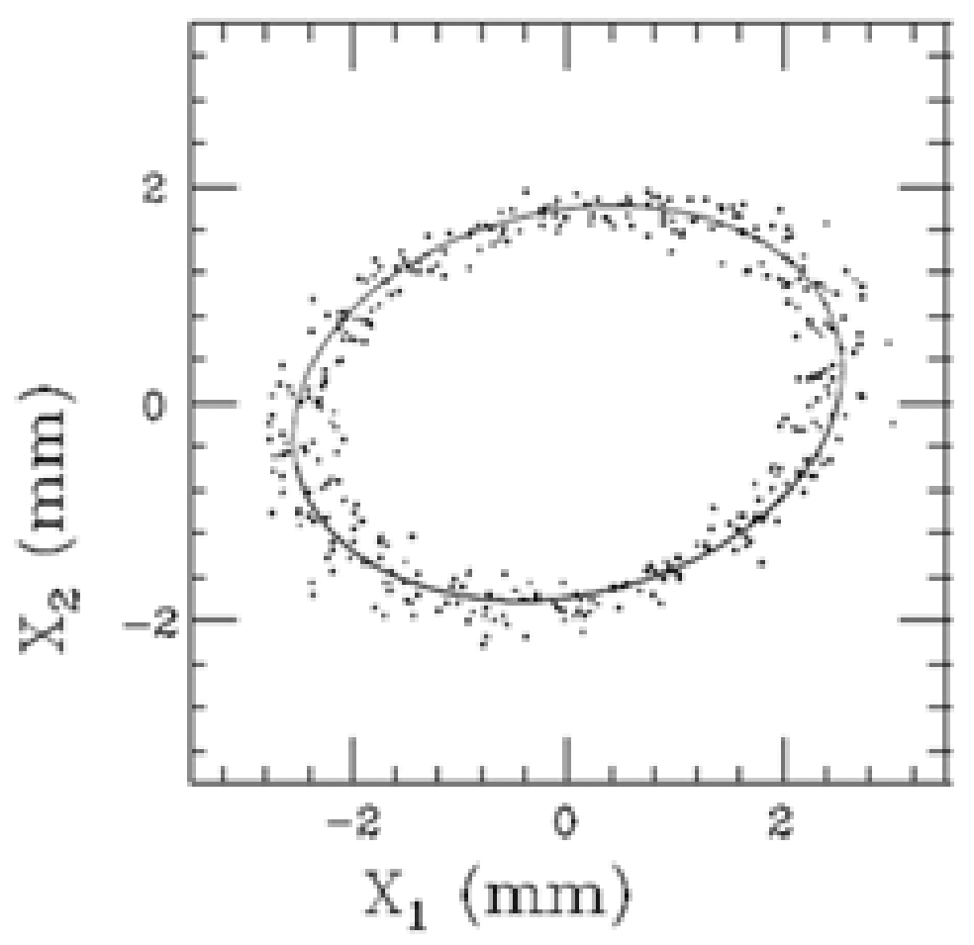
Two BPM Measurement – Is it a Poincare Section?
Two BPMs separated by π/2 are used to make a measure of X, X’.
This is only a Poincare Section if there is no vertical oscillation or synchrotron oscillation.
If there is, you have to wait until that
other dimension is at the same part of
its oscillation.
- i.e. throwaway all datapoints where
the y-oscillation is not maximum.
- If the fractional betatron tune is
~ 0.1, take only every tenth point.
see lec3_poincare.py
29
Jeffrey Eldred | MATLAB/Python for Accelerators
Notes:
29
29
29
29

Slide 30
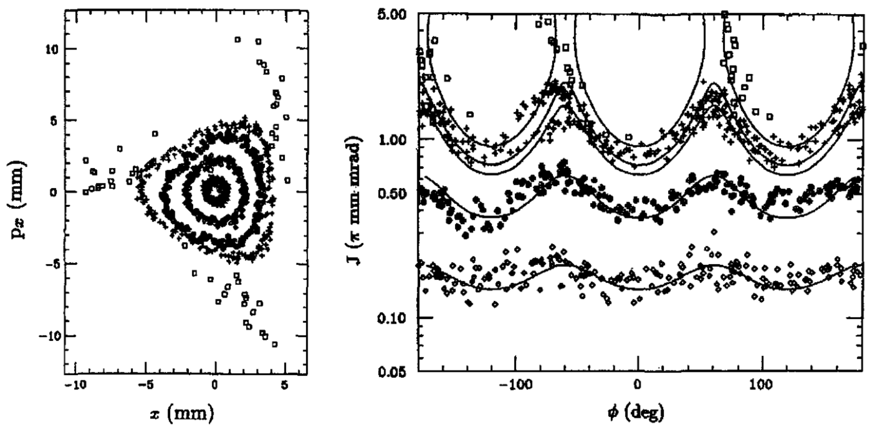
Poincare Section of Sextupole resonance
30
Jeffrey Eldred | MATLAB/Python for Accelerators
Notes:
30
30
30
30

Slide 31
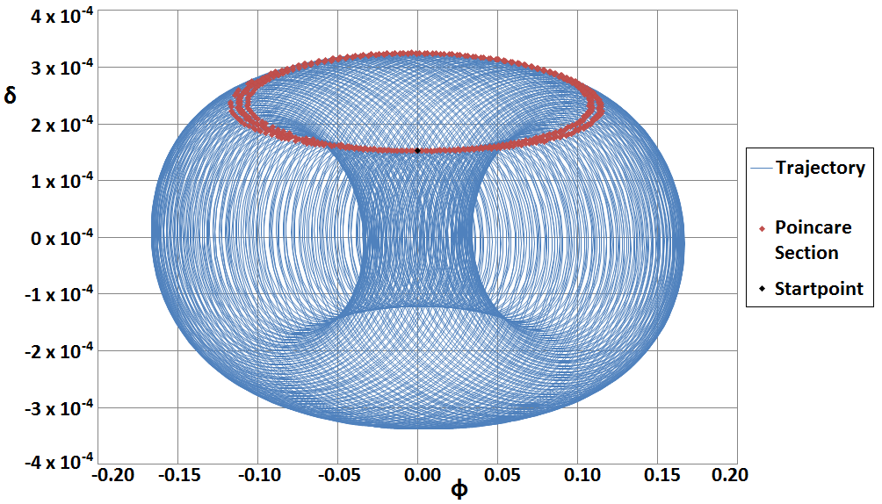
31
Another Example: Slip-stacking
31
Jeffrey Eldred | MATLAB/Python for Accelerators
Notes:
31
31
31

Slide 32
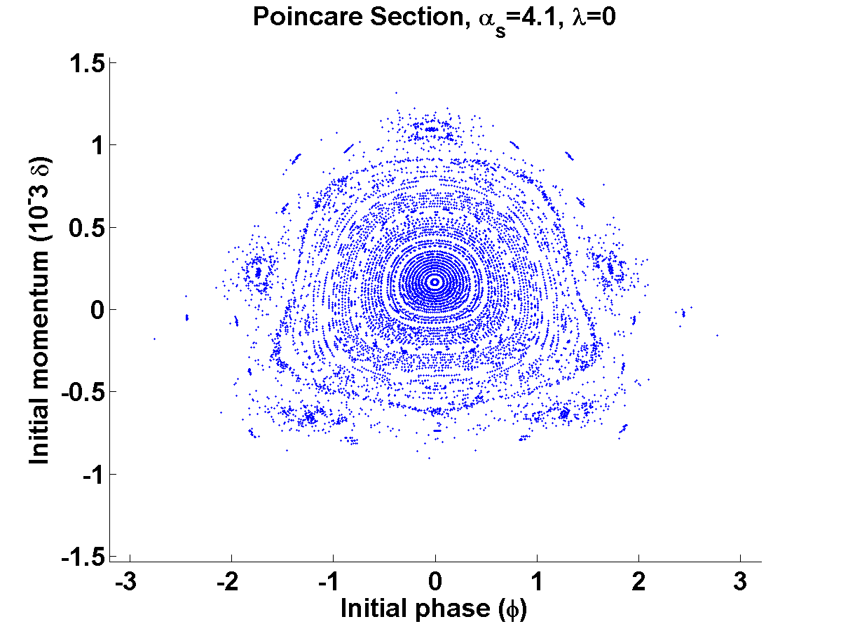
32
32
Jeffrey Eldred | MATLAB/Python for Accelerators
Notes:
32
32
32
32
32

